Slide 1

EARLY WARNING SYSTEM FOR FLOOD
DM Assignment
Ankit Raj - 1906534

Slide 2
INTRODUCTION
Early Warning System
The set of capacities needed to generate and disseminate timely and meaningful warning information to enable individuals communities and organisation threatened by a hazard to prepare and to act appropriately and in sufficient time to reduce the possibility to harm or loss.

Slide 3
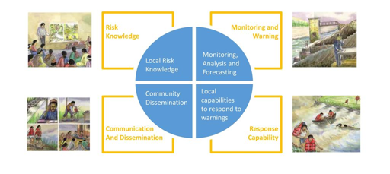
Early Warning System Components

Slide 4
Flood Forecasting Early Warning System
The purpose of the system is to provide timely warning regarding flood/flash-dloods events in the study area.Implementation in the Turyanchat catchment is under way.
The implementation of such system requires the use of :
A risk assessment
Data
Models
Platform to manage the different and to launch and couple the different models.

Slide 5
Turyanchay Risk Knowledge
Flood hazard mapping completed
High Resolution DEM for the study area was acquired.
Hydrological and hydraulic model were implemented in the study area
Extensive capacity building undertaken in hydraulic modelling and GIS.

Slide 6
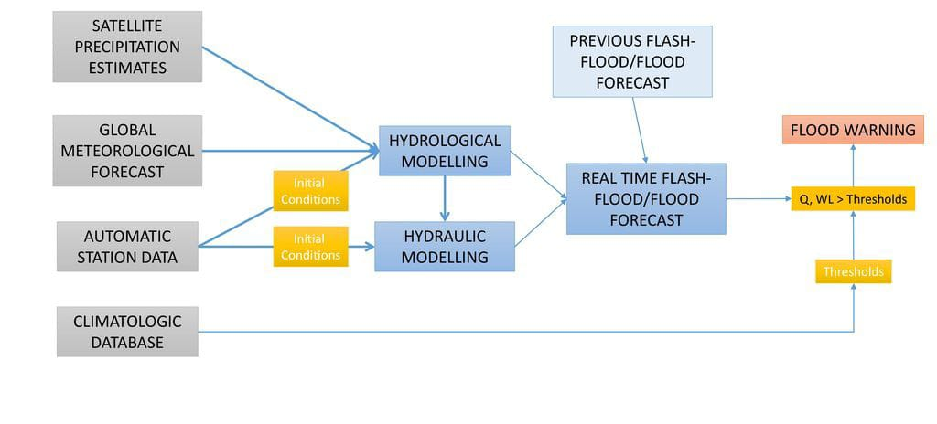

Slide 7
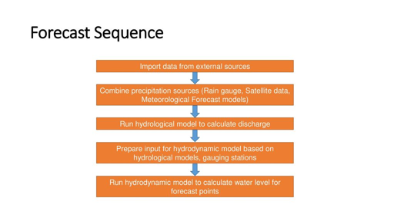
Forecast Sequence

Slide 8
Import Data from External Sources
Telementry data
Meteorological Station/Posts
Hydrological
Satellite Precipitation Estimates
Meteorological Forecasts

Slide 9
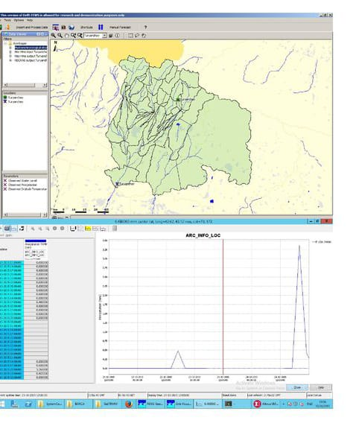
Telemetry Data
Data from the meteorological and hydrological station will be Incorporated into the system.

Slide 10
Hydrodynamic model
HEC-RAS is the hydrodynamic model within the platform.
Model adaptor is deft-fews.
Water level information from telemetry being used for initial conditions.
Water level calculated at specified locations.

Slide 11
Warning Level
Three different levels of warning will be defined depending on the time to the event and on the accuracy of the prediction.
Level alert (Be Aware )—48hr in advance-flood forecasting.
Level 2 alert (Be Aware)-24hr in advance-flood watch.
Level 3 alert (Be Aware)-0hr in advance-flood warning.

Slide 12
Thanks
Ankit Raj - 1906534

